Slide 1


ML22/23-13 Investigate Influence of parameter MaxNewSynapseCount
Team: TEAM AS
MD Fathir Ahmed Shishir (1344477)
Akash Saha (1345829)

Slide 2
Objective
Understand Multisequence Learning
Use of MaxNewSynapseCount in Temporal Memory
Influence of MaxNewSynapseCount while learning
Create report and provide some analysis

Slide 3
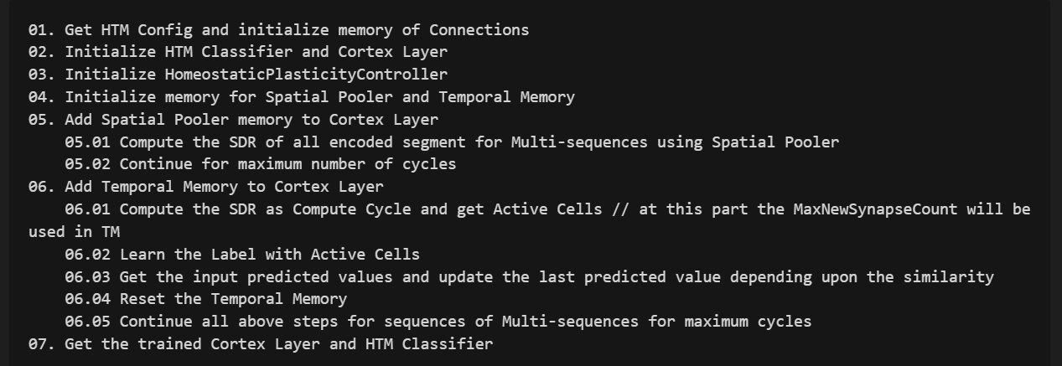
Approach
Understanding Multisequence Learning

Slide 4
Approach (continued)
HTM Analysis: Explored Temporal Memory and MaxNewSynapseCount
Adaptation: Modified MultiSequenceLearning for adjustable synapse counts.
Experimentation: Tested varying MaxNewSynapseCount impacts on learning and prediction.
Analysis: Assessed performance to identify optimal settings.

Slide 5



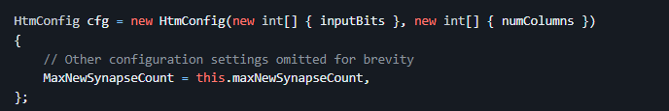
Implementation
Objective: Enable dynamic MaxNewSynapseCount adjustments.
Constructor Update:
Experiment Configuration:

Slide 6
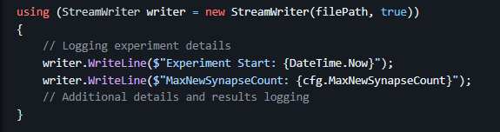
Implementation (continued)
Execution: Run experiments with varying MaxNewSynapseCount via Program.cs. Example: RunMultiSequenceLearningExperiment(20);
Data Logging: Capture outcomes in detail for analysis.
Purpose: Evaluate learning outcomes and predictive accuracy.

Slide 7
Results
Optimal MaxNewSynapseCount: A setting of 20 showed the best balance between learning speed and prediction accuracy, enhancing HTM network performance.
Diminishing Returns: Higher MaxNewSynapseCount values beyond 20 led to similar accuracy levels but with diminishing returns, indicating an efficiency threshold.
Foundation for Future Research: Results lay the groundwork for further exploration into HTM parameter tuning and suggest potential for cloud-based scalability and resource efficiency.

Slide 8


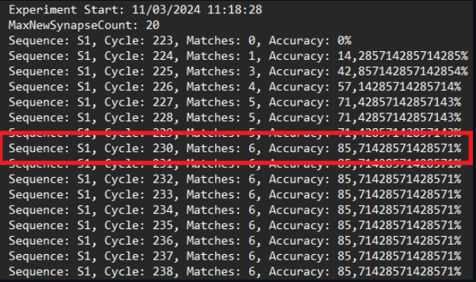
Results (continued) : Report

Slide 9
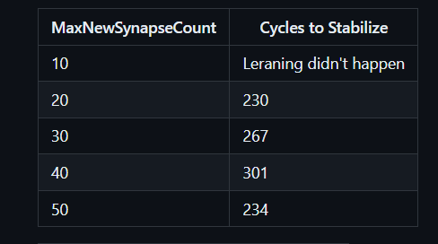
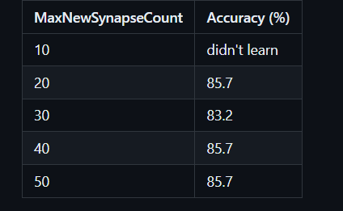
Results (continued) : Analysis

Slide 10
Discussion
Need to run with different dataset
Need to run in cloud for fast results

